Slide 1
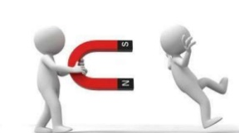
INTERMOLECULAR FORCES
The force hold the molecules together which can be attractive or repulsive

Slide 2

Inter-Ionic forces
On the other hand, inter-ionic forces that old ions together.

Slide 3
Inter-Ionic forces
These intermolecular forces are accountable for the properties of substances. Moreover, intermolecular forces also explain why substances exist as solid, liquids or gases at room temperature.

Slide 4
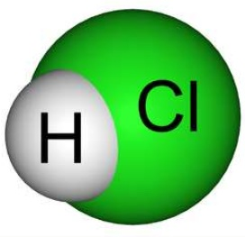
Dipole-Dipole forces
Dipole-Dipole forces are attractive forces existing between polar molecules (molecules that exhibit dipole moment) such as HCl

Slide 5
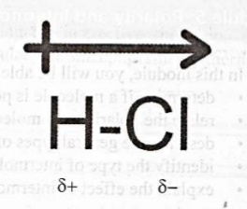
Dipole-Dipole forces
Because there is unequal sharing of electron between H and Cl atoms, partial positive and partial negative poles exist and are referred to as a dipole.

Slide 6
Dipole-Dipole forces
The more electronegative atom becomes partially negative and has most electron density, whereas the least electronegative becomes partially positive and has a lesser electron density.

Slide 7
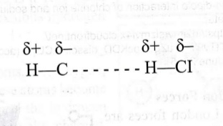
Dipole-Dipole forces
Because poles of opposite charges attract the partial negative end (i.e Cl atom) will be attracted to the partial positive end (i.e H atom) of another HCl molecule.

Slide 8
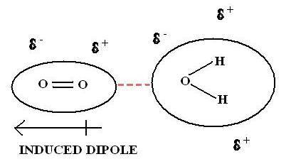
Dipole- Induced dipole Interaction
A polar molecule may sometimes polarise a neutral molecule which lies in its vicinity and thereby induce polarity in that molecule just like a magnet induces magnetic dipolarity in a neutral piece of iron lying close by. The induced dipole then interacts with the dipole moment of the first molecule and thereby the two molecules are attracted together. The magnitude of this interaction depend upon the magnitude of the dipole moment of the polar molecule and the polarizability of the neutral molecule.

Slide 9
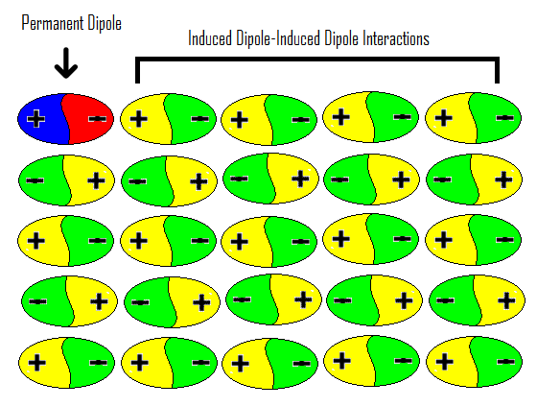
Induced dipole-Induced dipole Interaction(London Forces or Dispersive forces)
Are the weakest force that are formed due to the temporary dipole induced in non-polar molecules.
This force is also called Induced dipole-Induced dipole attraction.

Slide 10
EQUATIONS OF STATE FOR REAL GASES
REAL VS IDEAL GASES
Ideal Gases • Ideal gas may be defined as a gas which obeys the gas equation (PV=nRT) under all conditions of temperature and pressure; and hence the gas equation is also known as Ideal Gas Equation. • The ideal gas obeys the kinetic molecular theory of gases.
Real Gases • However, no gas is perfect and the concept of perfect gas is only theoretical. Gases tend to show ideal behaviour more and more as the temperature rises above the boiling points of their liquified forms and the pressure is lowered. Such gases are known as real gases. Thus a real gas may be defined as a gas which obeys the gas laws under low pressure and high temperature.

Slide 11
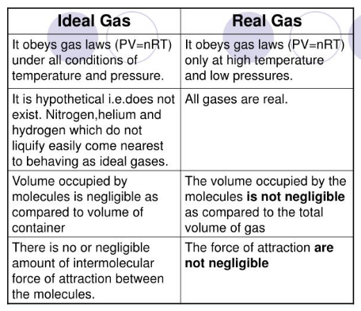

Slide 12
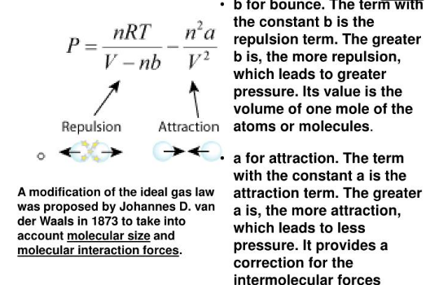
Quantitative ( Van der Waal’s equation)

Slide 13
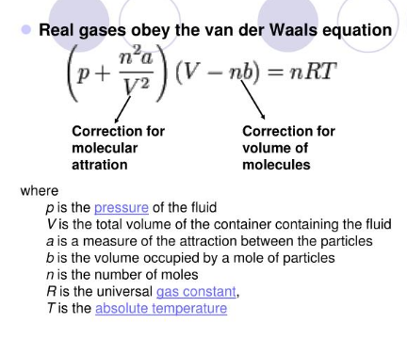

Slide 14
Critical Phenomenon
At critical temperature and pressure, the gas becomes identical with its liquid and is said to be in critical state. The smooth merging of the gas with its liquid state is referred to as the critical phenomenon.

Slide 15
Critical temperature
Critical temperature( Tc )of a gas may be defined as that temperature above which the gas cannot be liquefied, howsoever, high pressure we may apply on the gas.For example, the critical temperature of carbon di oxide is 31.10C. This means that it is not possible to liquefy carbon di oxide above 31.10C by any means.

Slide 16
Critical Pressure
The minimum pressure required to liquefy the gas at the critical temperature is called the Critical Pressure (Pc).For example, at 31.10C, carbon di oxide can be liquefied under a pressure of 72.9 atm. Thus the critical pressure of carbon di oxide is 72.9 atm.

Slide 17
Critical Volume
The volume occupied by one mole of the gas at the critical temperature and pressure is called the critical volume Vc. For example the critical volume of carbon di oxide is 940 ml per mole.

Slide 18
INVESTIGATION OF INTERNAL SRTRUCTURE OF A SOLID BY X-RAY DIFFRACTION-BRAGGS LAW
William Hendry Bragg and Sir William Lawrence Bragg, English Physicists, Father and Son both worked ion X-Ray crystallography. The son Bragg formulated the fundamental equation for X- Ray Diffraction. They were jointly awarded Nobel Prize in Physics in 1915.

Slide 19
INVESTIGATION OF INTERNAL SRTRUCTURE OF A SOLID BY X-RAY DIFFRACTION-BRAGGS LAW
When a beam of X-ray is passed through a crystal, the impression is taken on a photographic plate, a pattern called Diffraction pattern is obtained.
By using this pattern, Bragg investigated the structure of the Crystals of NaCl, KCl etc.

Slide 20
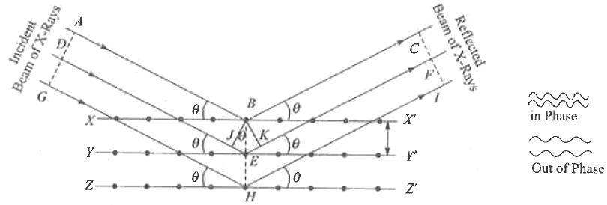
Reflection of X-rays by equidistant parallel planes

Slide 21
Since the reflected rays BC and EF are in the phase, the extra distance JEK traversed by the ray DE should be an integral multiple of the wavelength λ of the X-rays
i.e Distance JEK=nλ …..(1)
where n is an integer, i.e 1,2,3,4 etc. If d is the distance between the successive atomic phases,it is obvious from the figure that
JEK = 2d sin θ
So that Putting the value in eq. (1), we get
2d sin θ = nλ …..(2)
This equation is called Bragg’s equation.

Slide 22
Miller Indices
Various planes of a crystal are to be characterized and indexed for a better understanding of the crystal.
Miller introduced a set of integers (hkl) to specify a plane of the crystal. This set of three numbers, (hkl), is known as 'Millers indices' of a particular plane of a crystal.
“The Miller indices (hkl) of a plane of a crystal are inversely proportional to the intercepts of that plane on the three crystallographic axes”

Slide 23
To find the Miller Indices of a plane take the following
1. Find the intercepts on the crystal axes as multiples of the lattice constants a1, b2, c3.
2. Take reciprocals of these numbers and
3. Using an appropriate multiplier, convert the 1/intercept set to the smallest possible set of whole numbers.
4. Represent the above as a set of integers (hkl) for a given plane of a crystal.

Slide 24
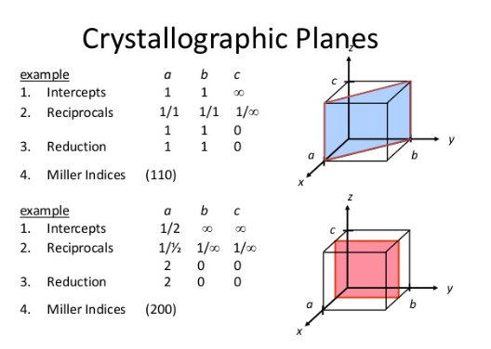

Slide 25
